Slide 1
Analysis of Farmer and Extension Agent Preference in Nepal using Analytic Hierarchy Process.
Brinton Reed*, Catherine Chan-Halbrendt, B.B. Tamang, and Narendra Chaudhary and Theodore Radovich.
Department of Natural Resource and Environmental Management

Slide 2
Background
Nepal
Among poorest in world;
Nearly ¼ population below poverty line;
Agriculture: 75% population, about 1/3 GDP.
SMARTS Project
Sustainable Management of Agroecological Resources for Tribal Societies;
Environmental degradation Severe malnutrition, loss of livelihood options;
Develop improved conservation practices and improve livelihoods.
(CIA World Fact book, 2012)
Notes:
On sloped and marginal land …. Subsistence farmers

Slide 3
Objectives
Analytic Hierarchy Process (AHP) to determine farmer and extension agent preferences for selected conservation agriculture production systems (CAPS) and current farmer practice (FP).
Rank production systems in order of preference and identify knowledge or training gaps.
Facilitate mutual understanding among farmers and extension agents.
Notes:
depends on farmer perceptions and knowledge sharing between farmers and extension staff.

Slide 4
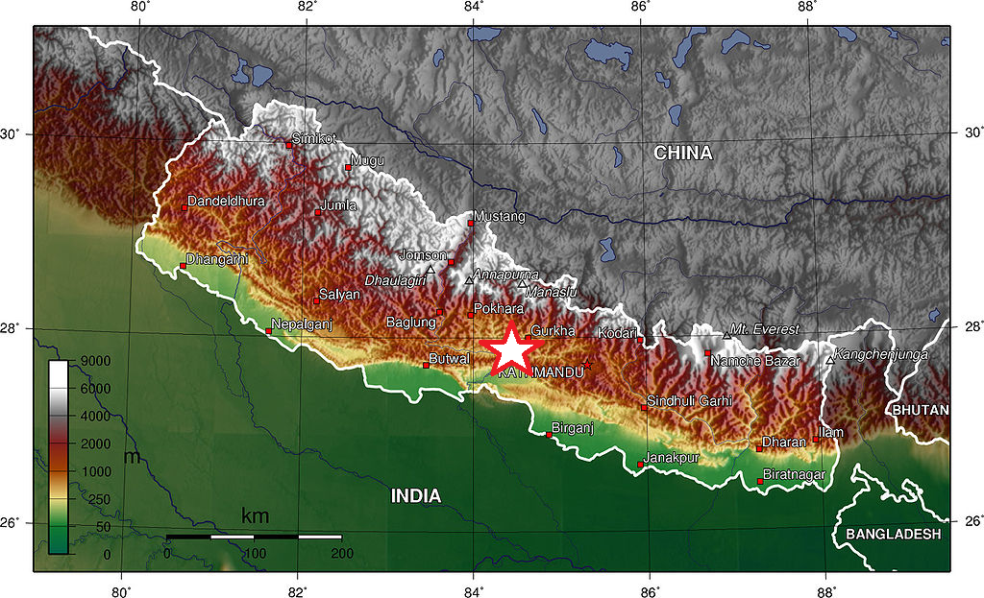
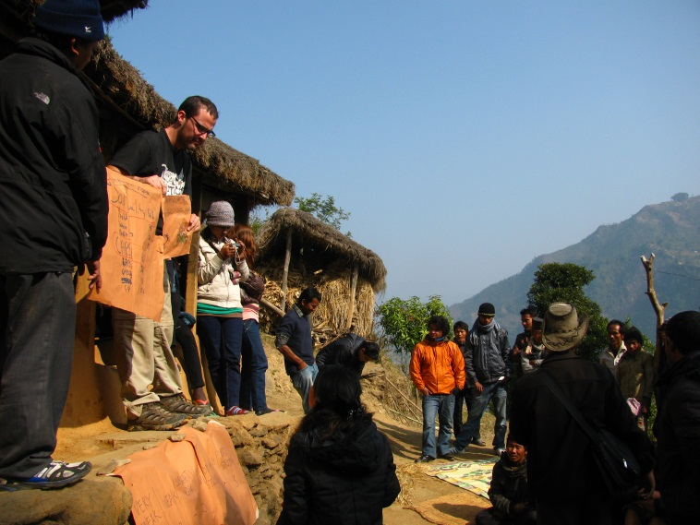
Methods
January 2012, AHP conducted at three villages, Local Initiatives for Biodiversity Research and Development (LIBIRD), and Institute of Agriculture and Animal Science (IAAS).
Notes:
three villages and two organizations that provide extension services. Thumka, Hyrkrang, Khola Gaun. Middle Hills Region. Tribhuvan

Slide 5
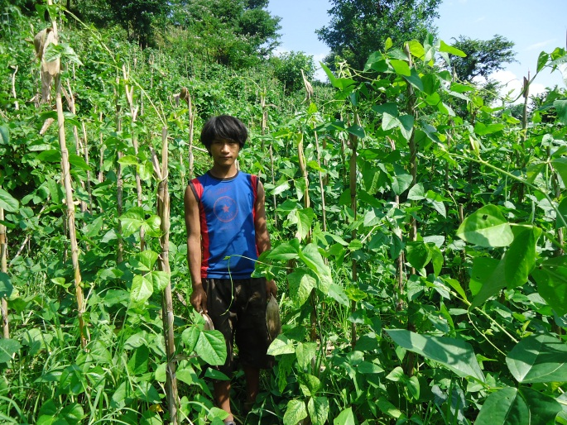
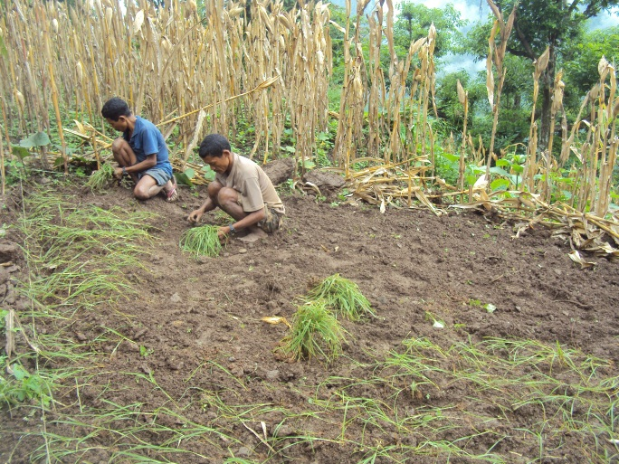
Methods
Production Systems
(FT/M): Full Tillage, Millet Monocrop
(FT/C): Full Tillage, Cowpea Monocrop
(FT/M+C): Full Tillage, Cowpea/Millet Intercrop
(ST/M+C): Strip Tillage, Cowpea/Millet Intercrop
Notes:
Worked with farmers and agronomists to identify three Conservation Agriculture Production Systems. We used FP as control.
Idea is to test effectivness of intercropping and cover cropping with legume, ST

Slide 6
Methods
Analytic Hierarchy Process
A multi-criteria, decision-making method;
Breaks down complex decisions into a series of simple side-by-side comparisons in order to rank options and objectives;
Accounts for varying and contradictory viewpoints;
AHP Software: Expert Choice 11.
(Vainiunas et al., 2009)
Notes:
Goal: Buying a car. Objectives: A/C, power windows, 4x4. Options: Jeep Wrangler, Honda Civic, Ford F-150.

Slide 7
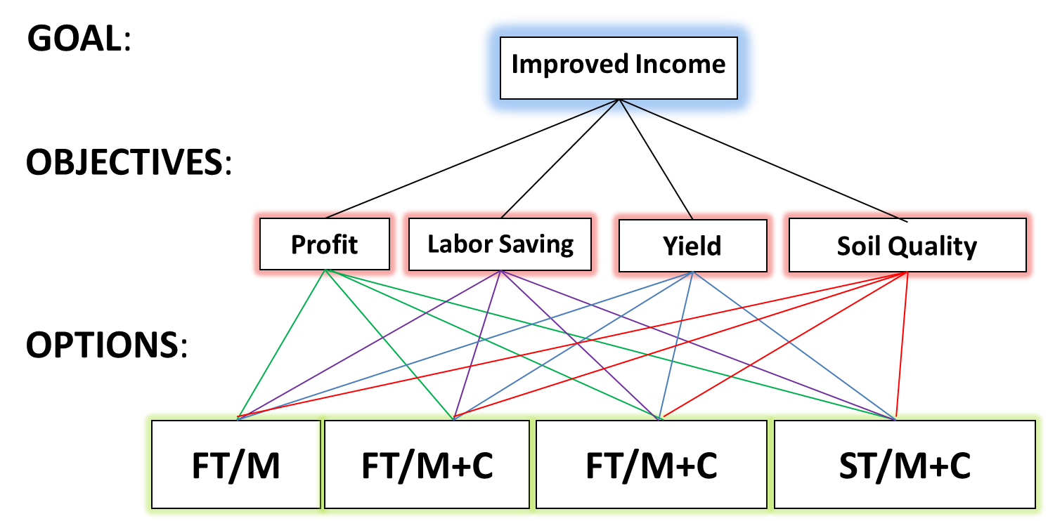
Methods
AHP Hierarchy

Slide 8
Results & Discussion
 | IAAS | LIBIRD | Thumka | Hyrakrang | Khola Gaun
Objectives | Soil Quality (43%) | Yield (35%) | Soil Quality (58%) | Soil Quality (53%) | Soil Quality (67%)
Soil Quality | (ST/M+C) (66%) | (ST/M+C) (42%) | (FT/C) (58%) | (FT/C) (50%) | (FT/C) (40%)
Options
First Preference | (ST/M+C) (56%) | (ST/M+C) (41%) | (FT/C) (48%) | (FT/C) (49%) | (ST/M+C) /(FT/C) (35%)
Second Preference | (FT/M+C) (20%) | (FT/C) (29%) | (FT/M+C) (25%) | (FT/M+C) (21%) | (FT/C) (35%)
Notes:
1. All rated FP lowest in terms of income and soil quality: a) Non-market value of millet (factor in adoption)
SQ>Y in Villages: a) Villagers thinking about sustained production, not just short term (yields)
In terms of SQ, villagers do not value ST over FT: a) Lack of understanding of ST value b) short term mentality c) lack of knowledge on intercropping among staff

Slide 9
Conclusions
Farmers prefer short term profits but concerned with long-term productivity;
Knowledge gap regarding the benefits of strip tillage on soil quality;
Lack of understanding between farmers and extension agents regarding the effectiveness of intercropping.
Recommendation: Increase famer education and communications by conducting additional focus groups/workshops to address specific issues.
Notes:
While conducting AHP, we realized that farmers didn’t prefer intercropping as varieties used shading problems in the villages. Since then, made adjustments.
-for specific issues.

Slide 10
Thank You.
नमस्ते
References
CIA , “Nepal,” CIA World Factbook, 2012, https://www.cia.gov/library/publications/the-world-factbook/geos/np.html (11April 2012).
Vainiunas, P., E.K. Zavadskas, F. Peldschus, Z. Turskis, J. Tamosaitiene “Model of Construction Design Projects’ Managers Qualifying by Applying Analytic Hierarchy Process and Bayes Rule.” in Knowledge-Based Technologies and OR Methodologies for Stragetic Decisions of Sustainable Development, 30 September 2009. (5th International Vilnius Conference, Lithuania, 148-153.

